Slide 1
Year 5 - Spring - Block 1
Multiplication & Division

Slide 2
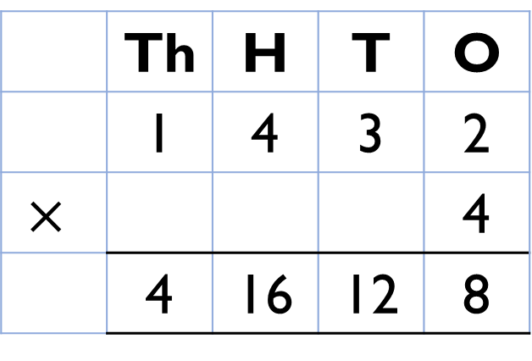
Alex calculated 1,432 $×$ 4
Here is her answer.
1,432 $×$ 4 $=$ 416,128
Can you explain what Alex has done wrong?
 | Th | H | T | O
 | 1 | 4 | 3 | 2
$$×$$ |  |  |  | 4
 | 4 | 16 | 12 | 8

Slide 3
Can you work out the missing numbers using the clues?
The 4 digits being multiplied by 5 are consecutive numbers.
The first 2 digits of the product are the same.
The fourth and fifth digits of the answer add to make the third.
$$×$$
5

Slide 4
Eva says,
What mistake has Eva made?
Explain your answer.
To multiply 23 by 57 I just need to calculate 20 $×$ 50 and 3 $×$ 7 and then add the totals.

Slide 5
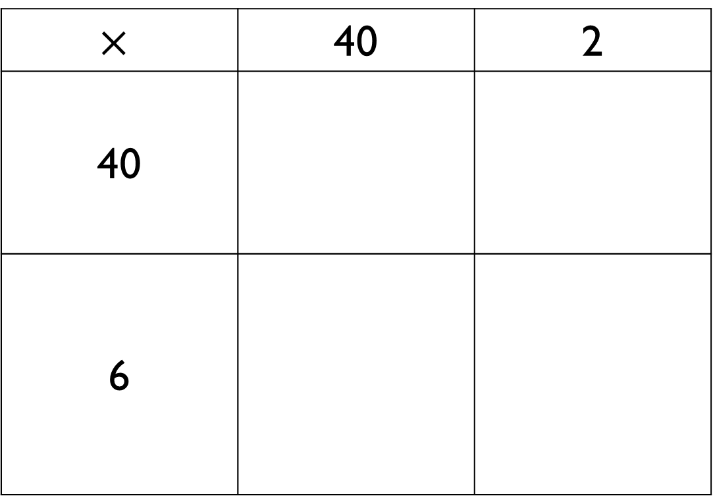
Amir hasn’t finished his calculation. Complete the missing information and record the calculation with an answer.
$$×$$ | 40 | 2
40
6

Slide 6
Farmer Ron has a field that measures 53 m long and 25 m wide.
Farmer Annie has a field that measures 52 m long and 26 m wide.
Dora thinks that they will have the same area because the numbers have only changed by one digit each.
Do you agree? Prove it.

Slide 7
Tommy says,
Do you agree? Explain your answer.
It is not possible to make 999 by multiplying two 2-digit numbers.

Slide 8
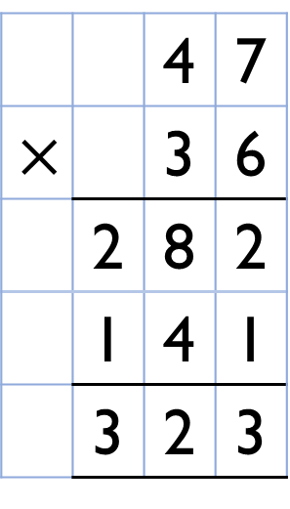
Amir has multiplied 47 by 36
Alex says,
Who is correct? What mistake has been made?
 |  | 4 | 7
$$×$$ |  | 3 | 6
 | 2 | 8 | 2
 | 1 | 4 | 1
 | 3 | 2 | 3
Amir is wrong because the answer should be 1,692 not 323

Slide 9
22 $×$ 111 $=$ 2442
23 $×$ 111 $=$ 2553
24 $×$ 111 $=$ 2664
What do you think the answer to 25 $×$ 111 will be?
What do you notice?
Does this always work?

Slide 10
Pencils come in boxes of 64
A school bought 270 boxes.
Rulers come in packs of 46
A school bought 720 packs.
How many more rulers were ordered than pencils?

Slide 11
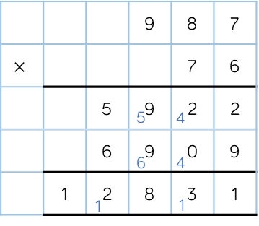
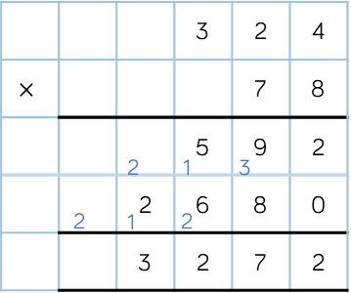
Here are examples of Dexter’s maths work.
He has made a mistake in each question.
Can you spot it and explain why it’s wrong? Correct each calculation.
$$×$$

Slide 12
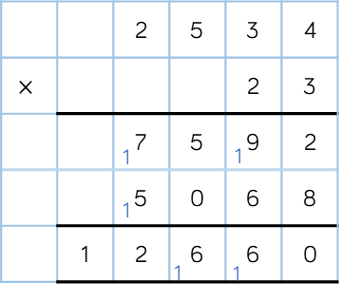
Spot the Mistakes
Can you spot and correct the errors in the calculation?
$$×$$

Slide 13
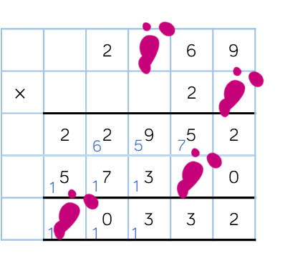
Teddy has spilt some paint on his calculation.
What are the missing digits?
What do you notice?
$$×$$

Slide 14
Jack is calculating 2,240 $÷$ 7
He says you can’t do it because 7 is larger than all of the digits in the number.
Do you agree with Jack?
Explain your answer.

Slide 15
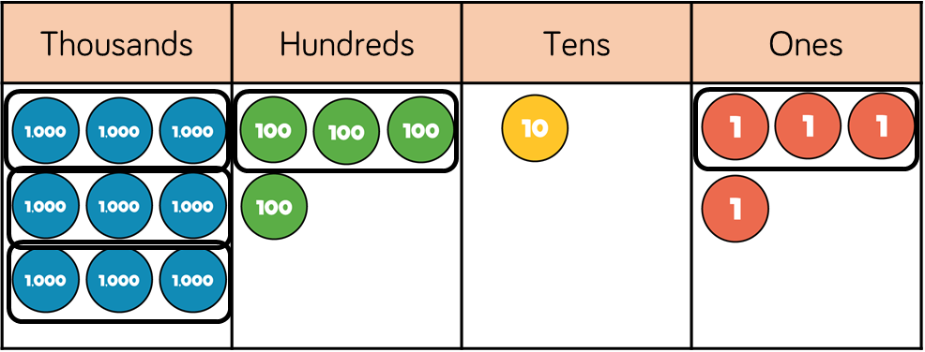
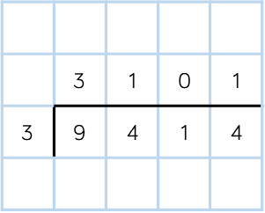
Spot the Mistake
Explain and correct the working.
Thousands | Hundreds | Tens | Ones

Slide 16
I am thinking of a 3-digit number.
When it is divided by 9, the
remainder is 3
When it is divided by 2, the
remainder is 1
When it is divided by 5, the
remainder is 4
What is my number?

Slide 17
Always, Sometimes, Never?
765 $÷$ 4 $=$ 191 remainder 1
How many possible examples can you find?
A three-digit number made of consecutive descending digits divided by the next descending digit always has a remainder of 1

